Slide 1


Welcome to the MN M365 Fall Admin Workshop Day 2021!
Please help us drive event awareness by tweeting and posting about your experience at the Workshop:
@o365MN #M365WorkshopDay
Thank you for your participation!

Slide 2
Oh No! The Presentation is TODAY?!?!?!?!?
It’s a Live Event AND a Teams Meeting?
How am I going to show both within Microsoft Teams?
It’s going to be an inception thing (Teams meeting about a Teams webinar and a Teams Live Event)
This is going to be tricky to say the least
Live Events, 3rd party services, OBS – Open Broadcaster Software, Live Events vs a Webinar)
I wonder how a TV network would handle this?

Slide 3
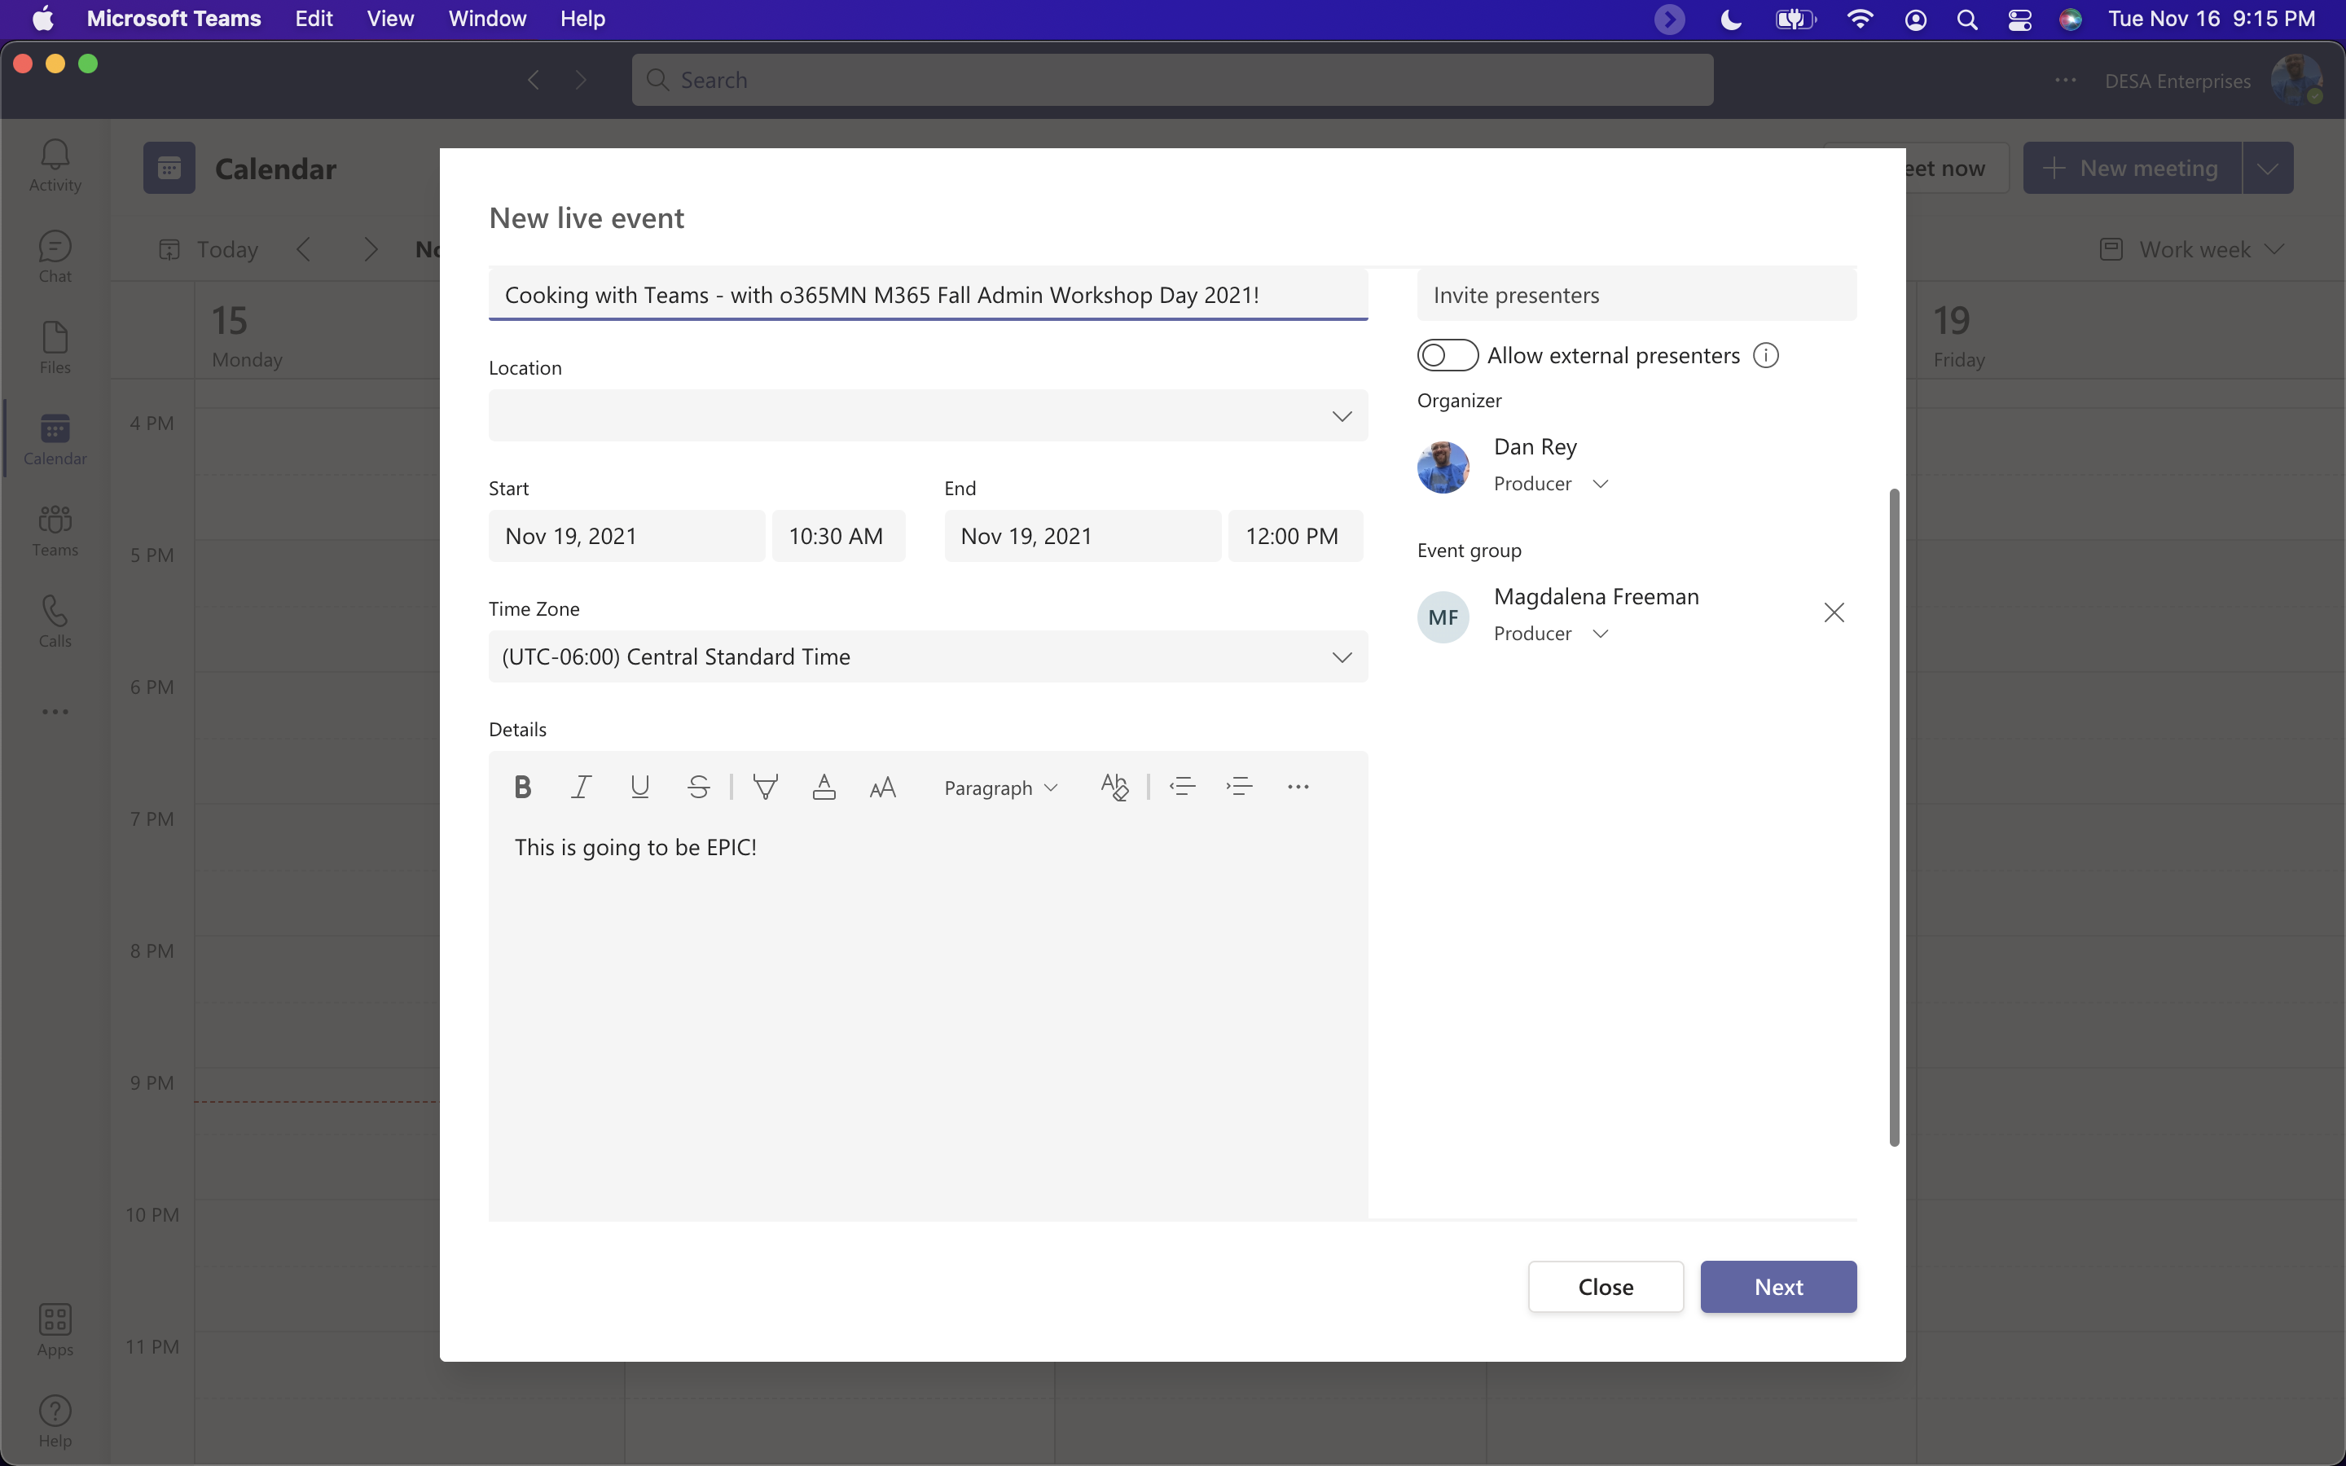
Live Events are PRODUCED

Slide 4
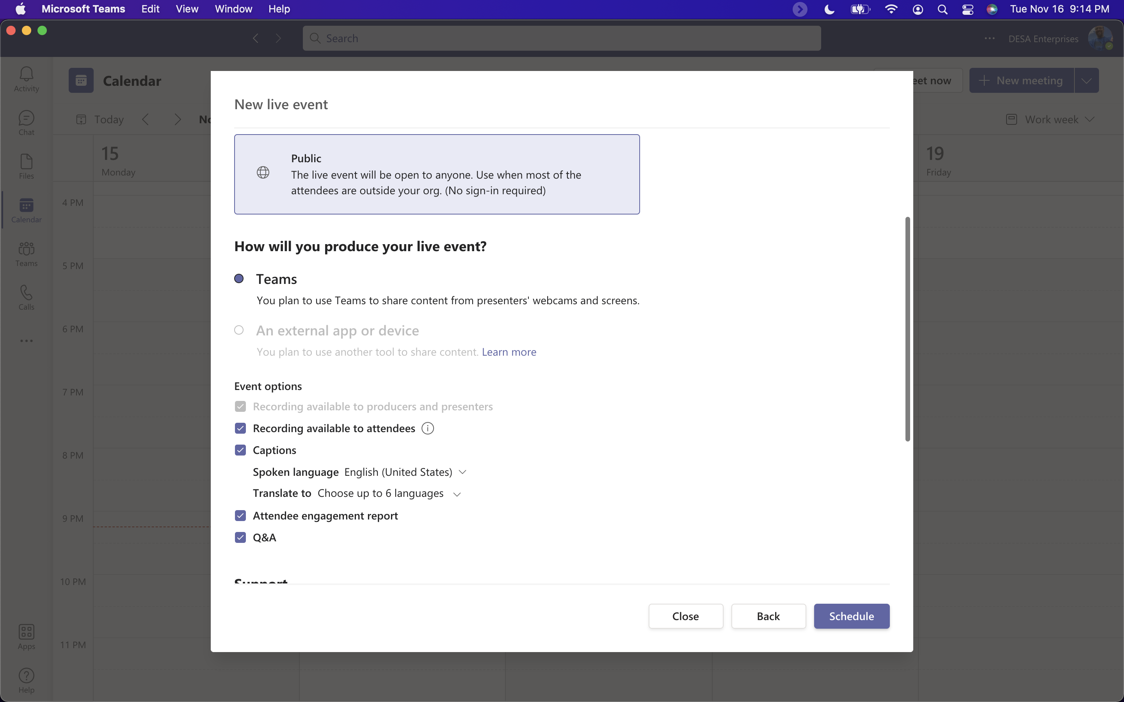
Options with only internal presenters:

Slide 5
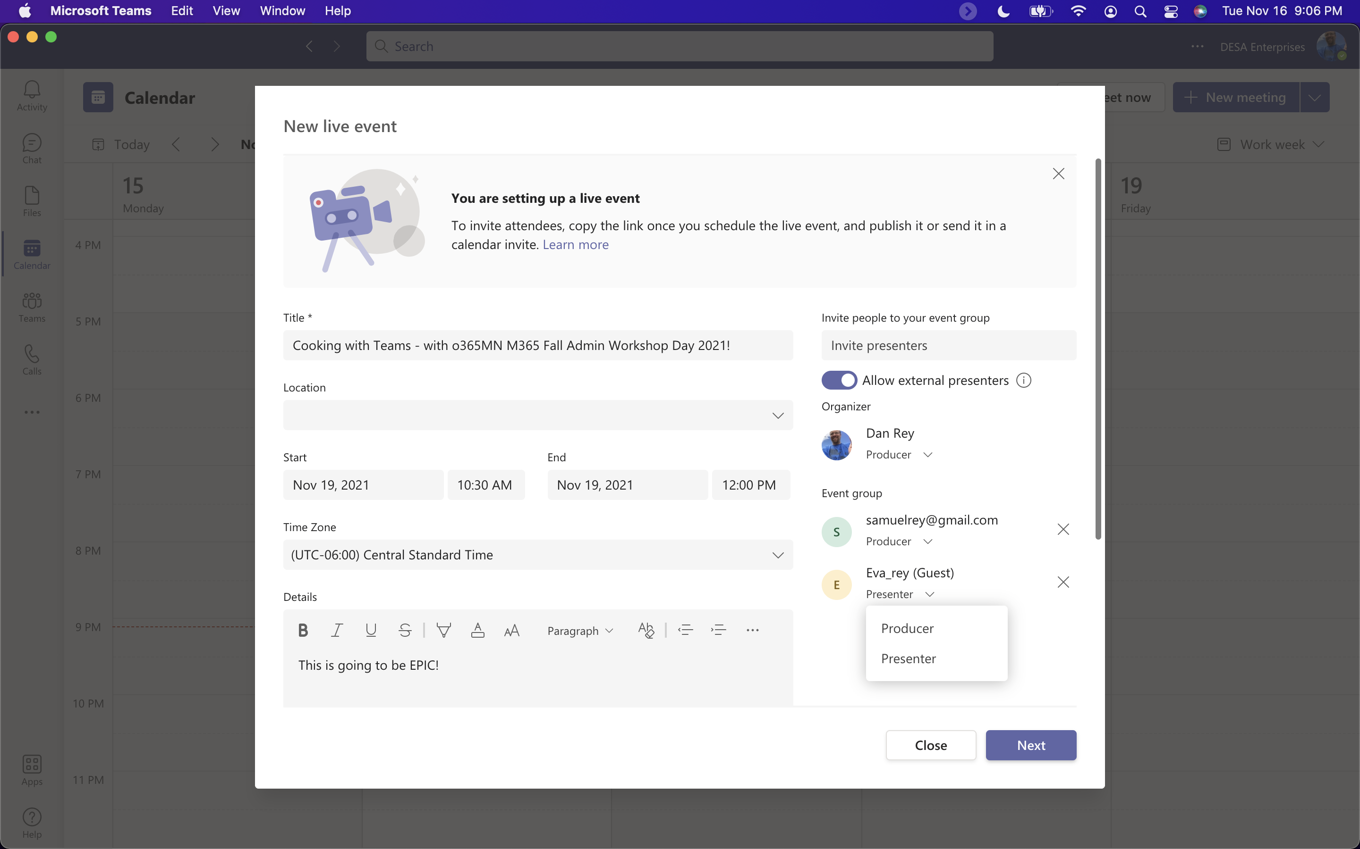
Live Events are PRODUCED

Slide 6
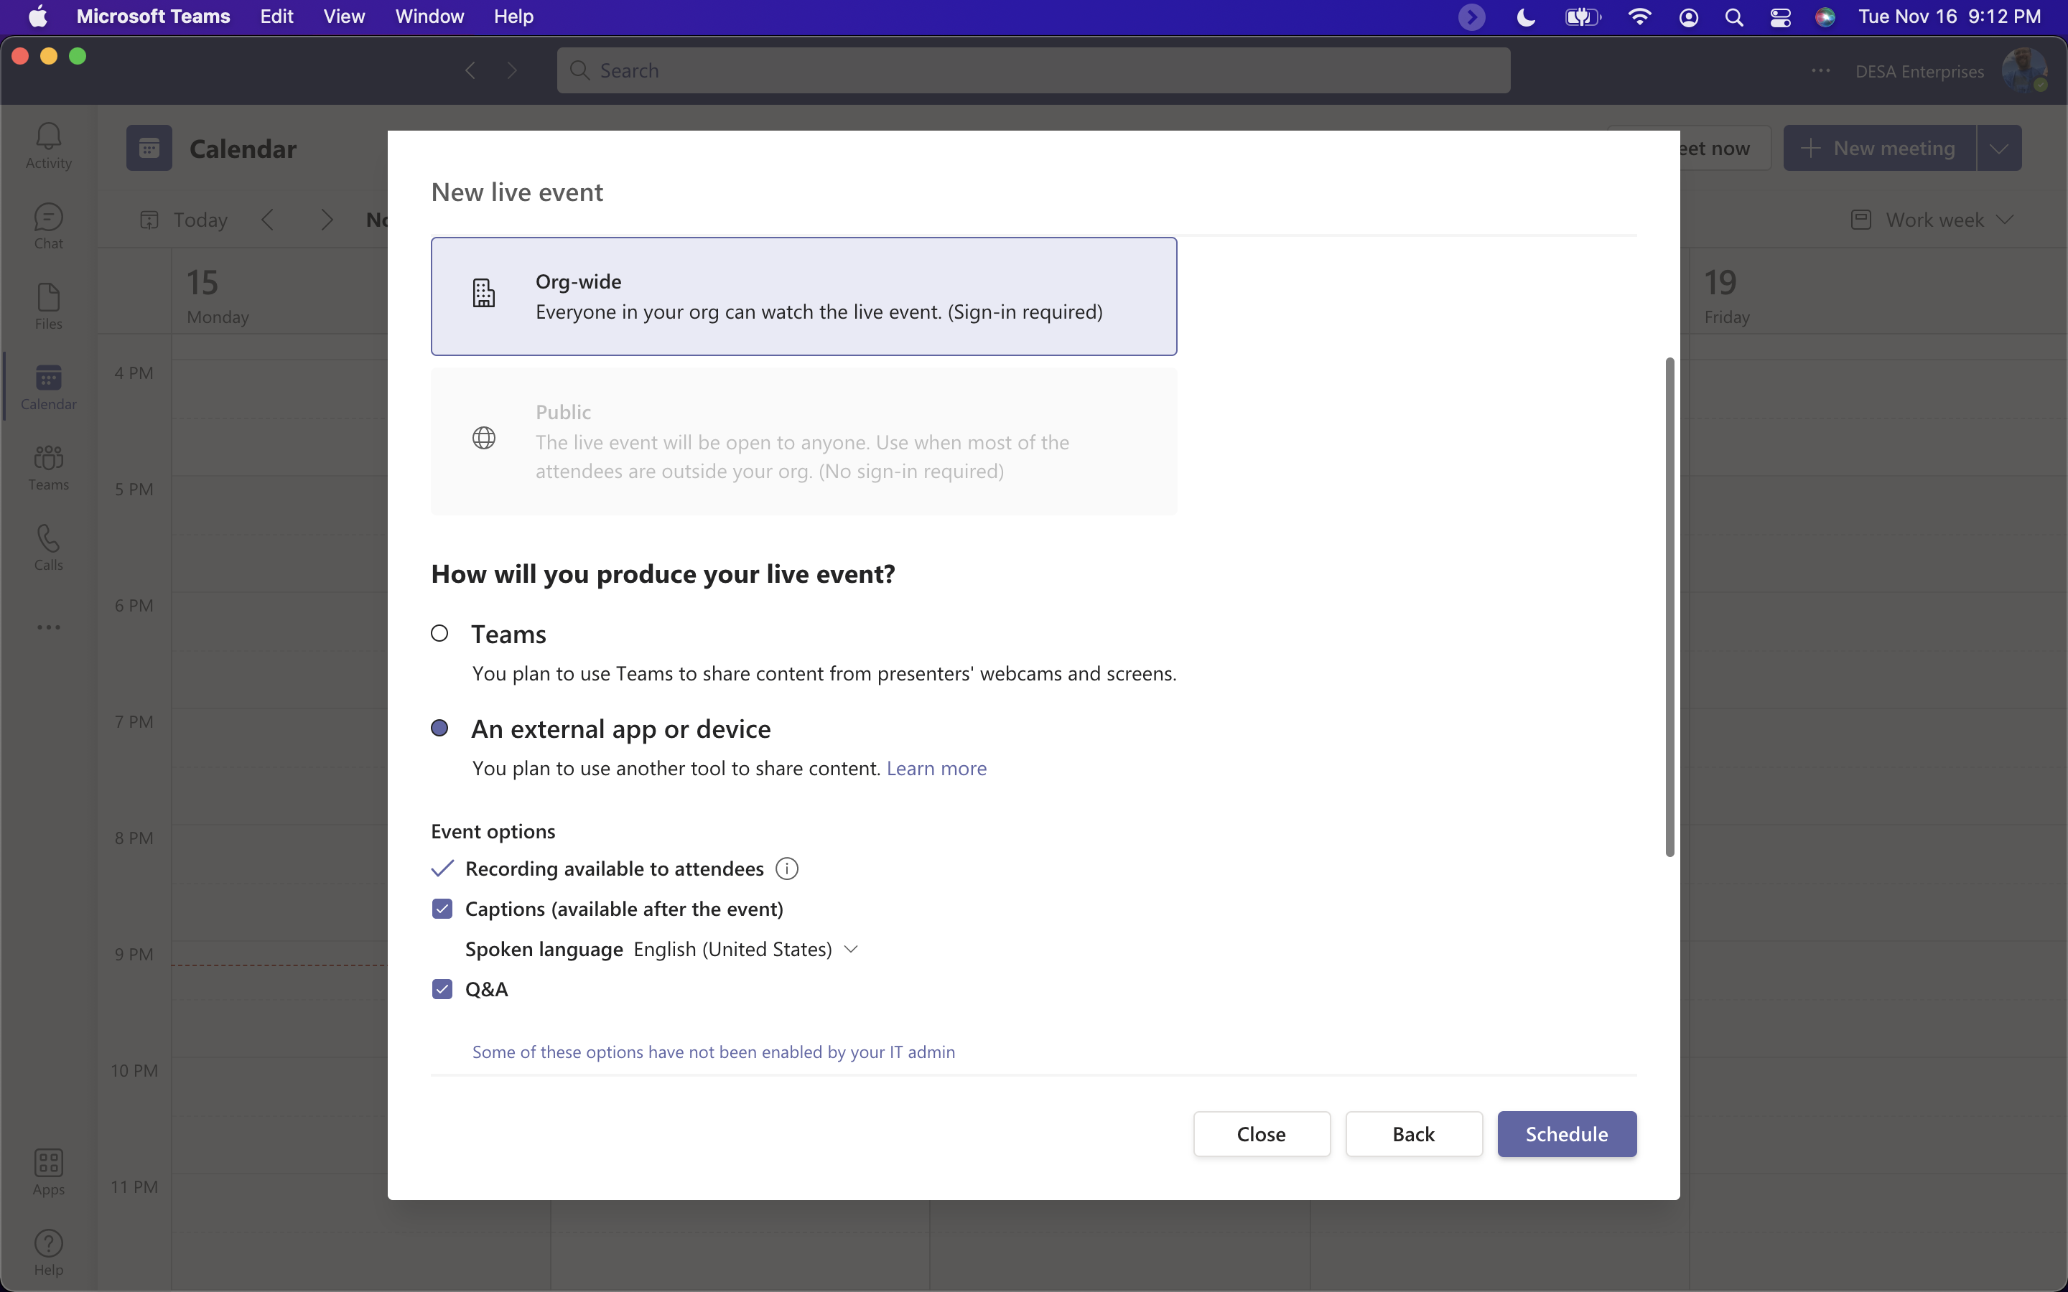
Live Events without external presenters (and external app controls many of those settings!)
Notes:
https://support.microsoft.com/en-us/office/produce-a-teams-live-event-using-an-external-app-or-device-b0026c9d-fd37-4bb3-bffc-6961f221fbe9

Slide 7
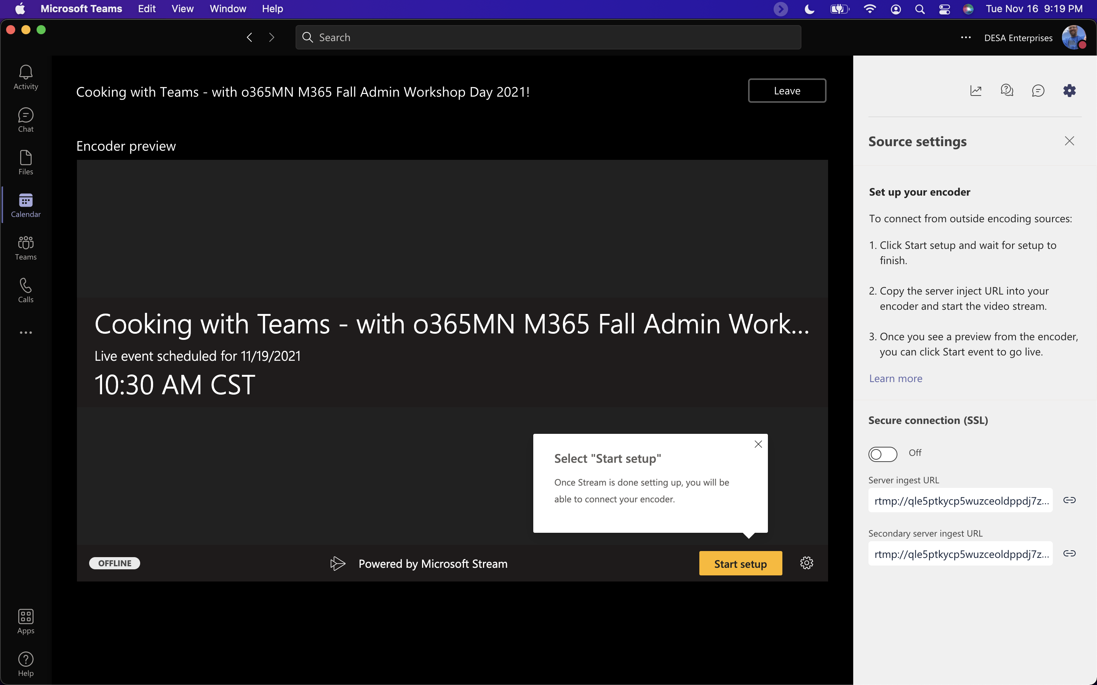
External App or Device

Slide 8
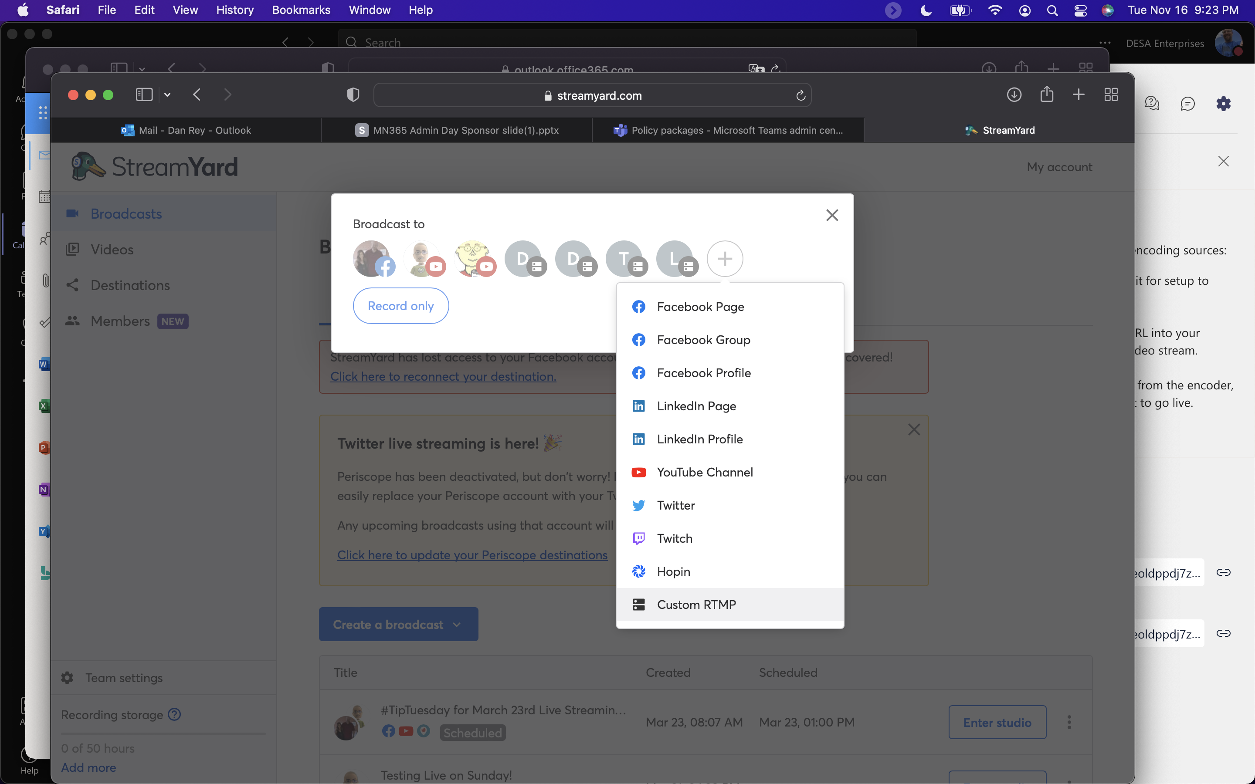
StreamYard – Add a Custom RTMP

Slide 9
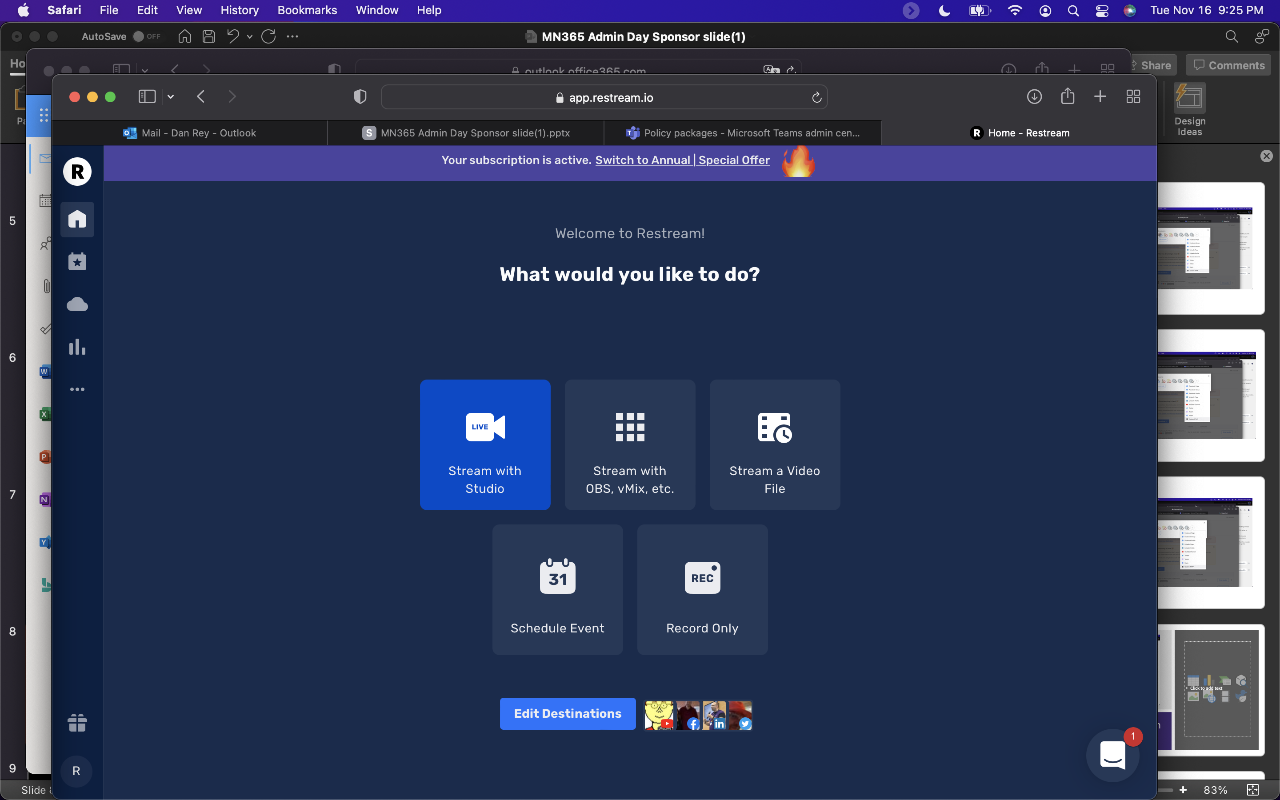

Slide 10
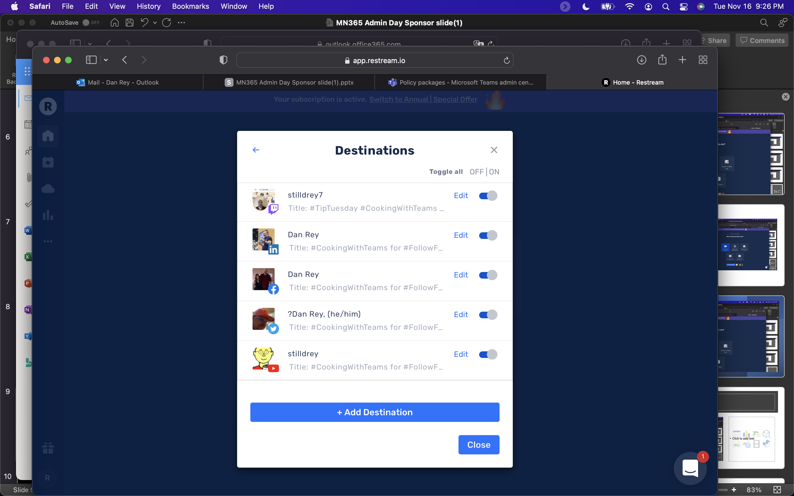

Slide 11
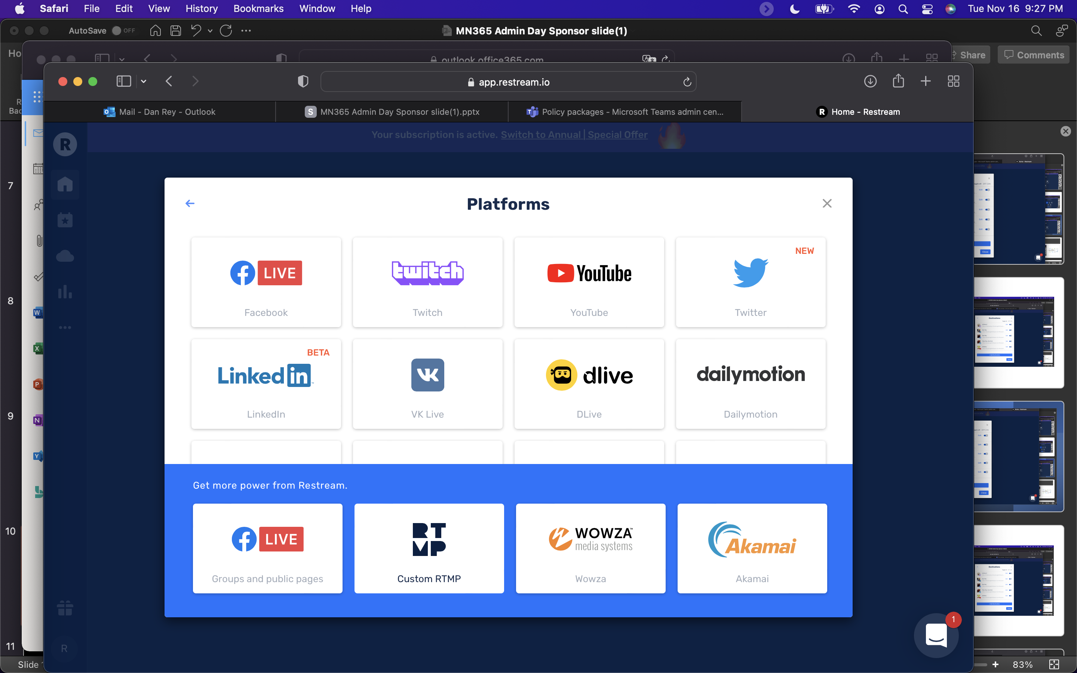

Slide 12
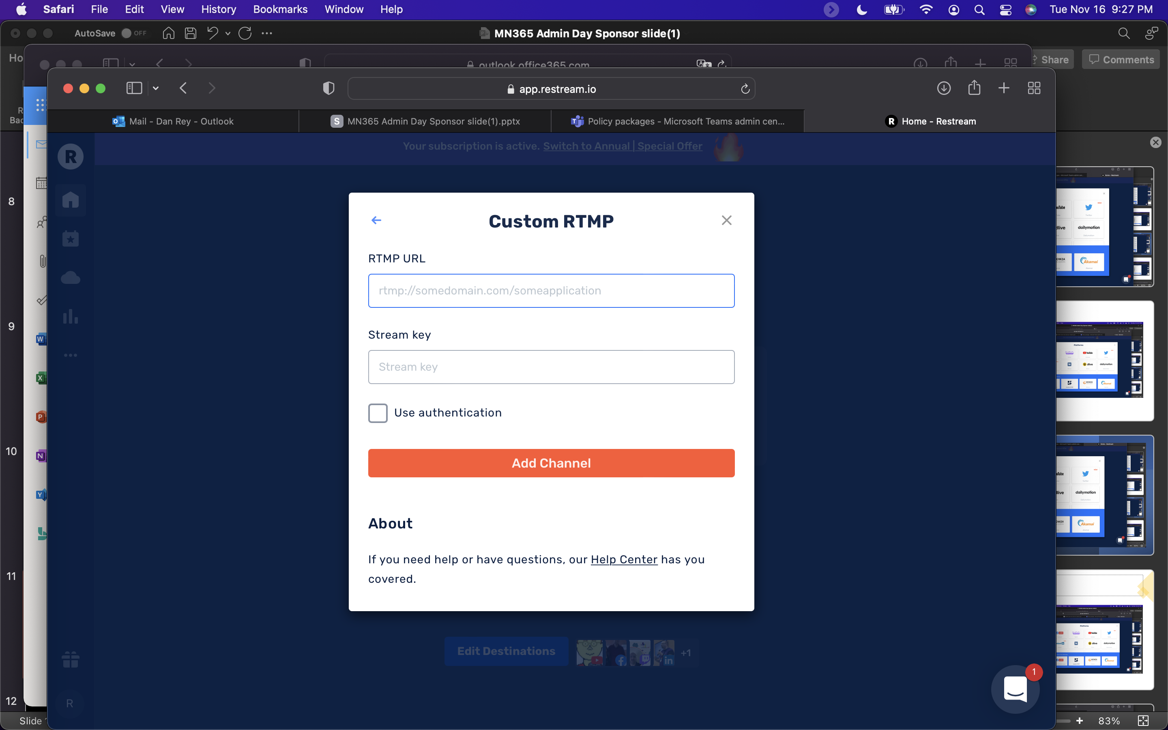

Slide 13
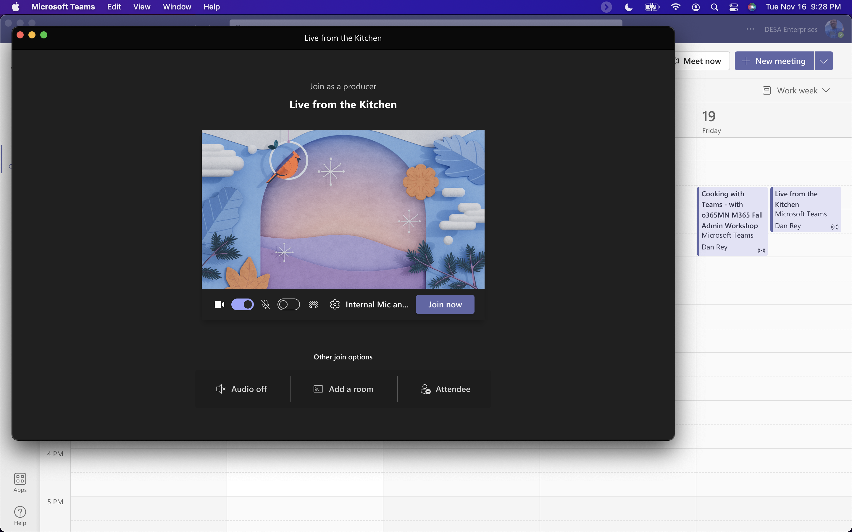

Slide 14
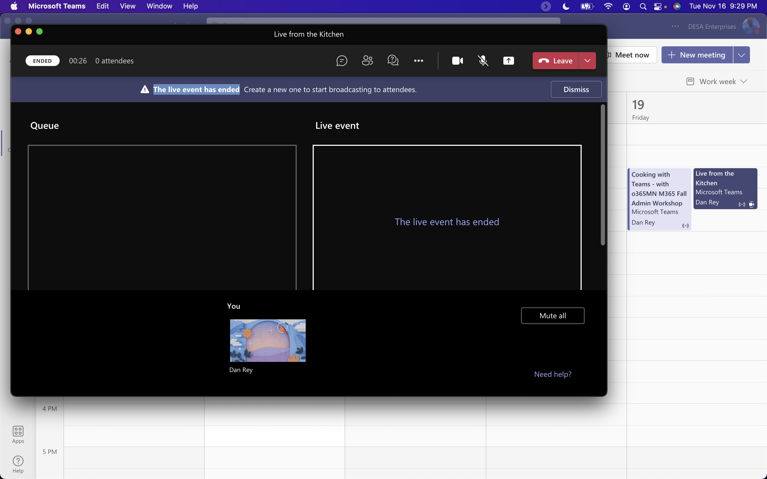

Slide 15
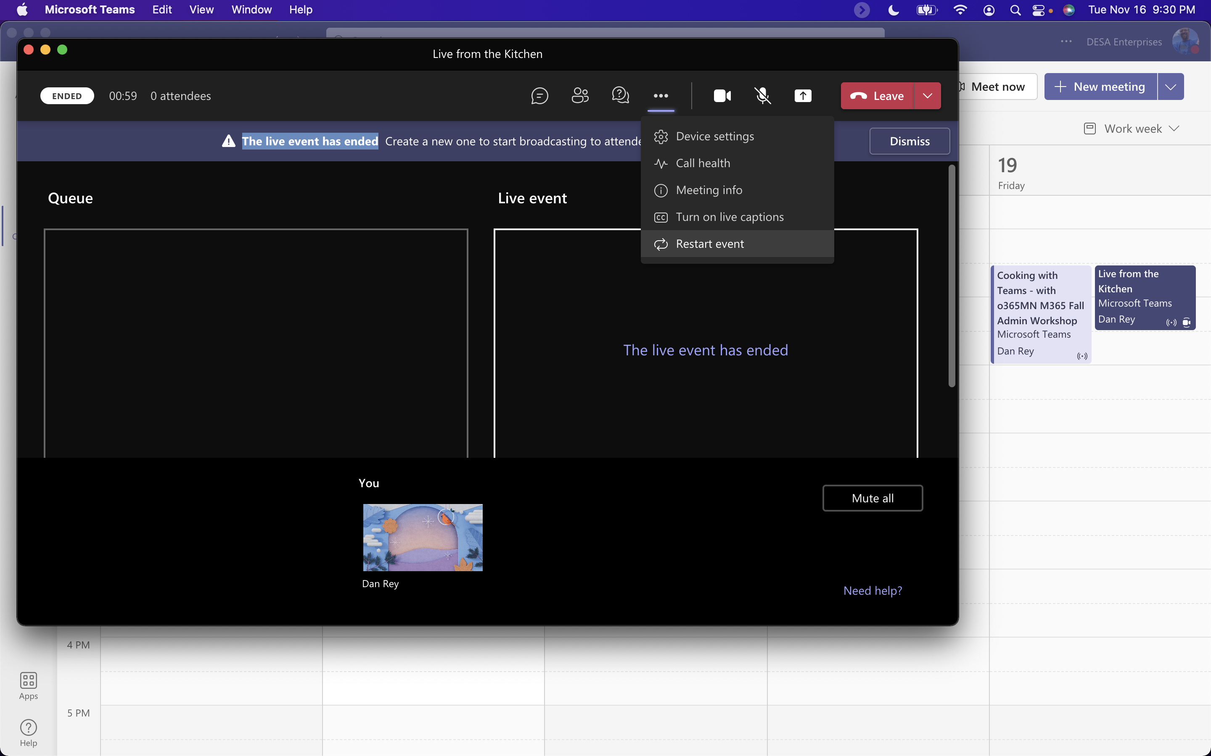
NEW: Restart a Live Event!!!

Slide 16
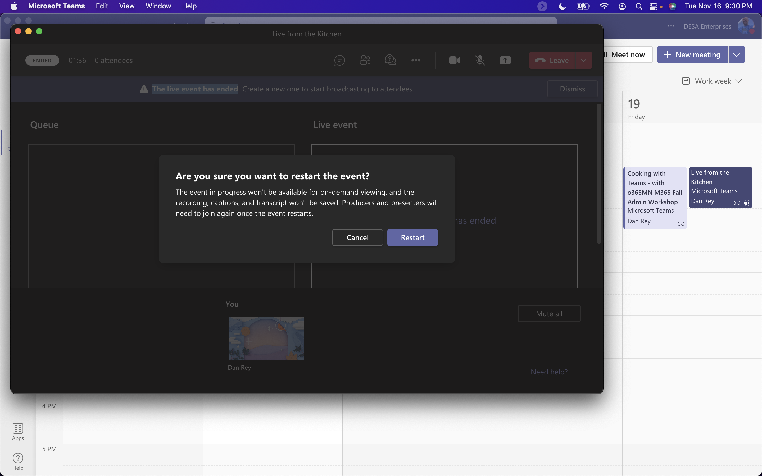
Warning/Implication to restarting a Live Event

Slide 17
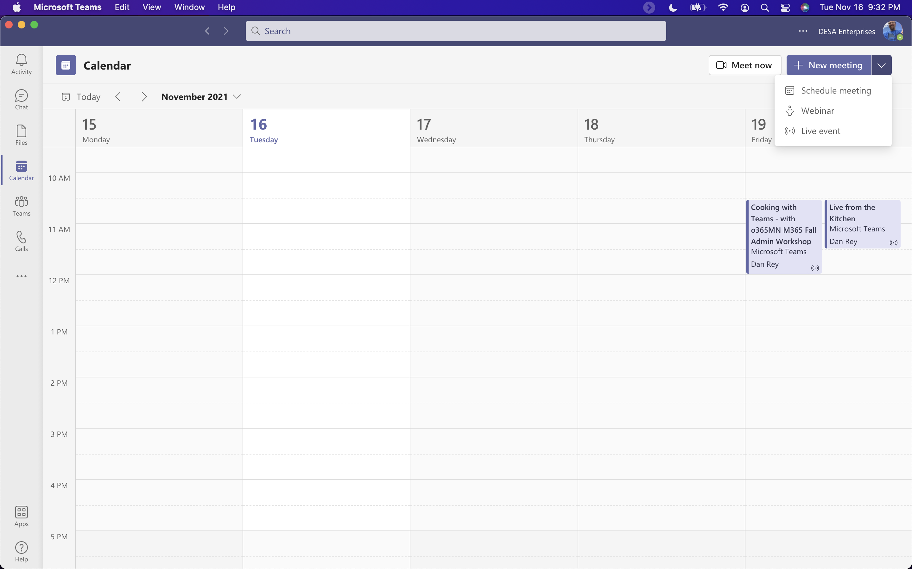
Live Event vs a Webinar

Slide 18
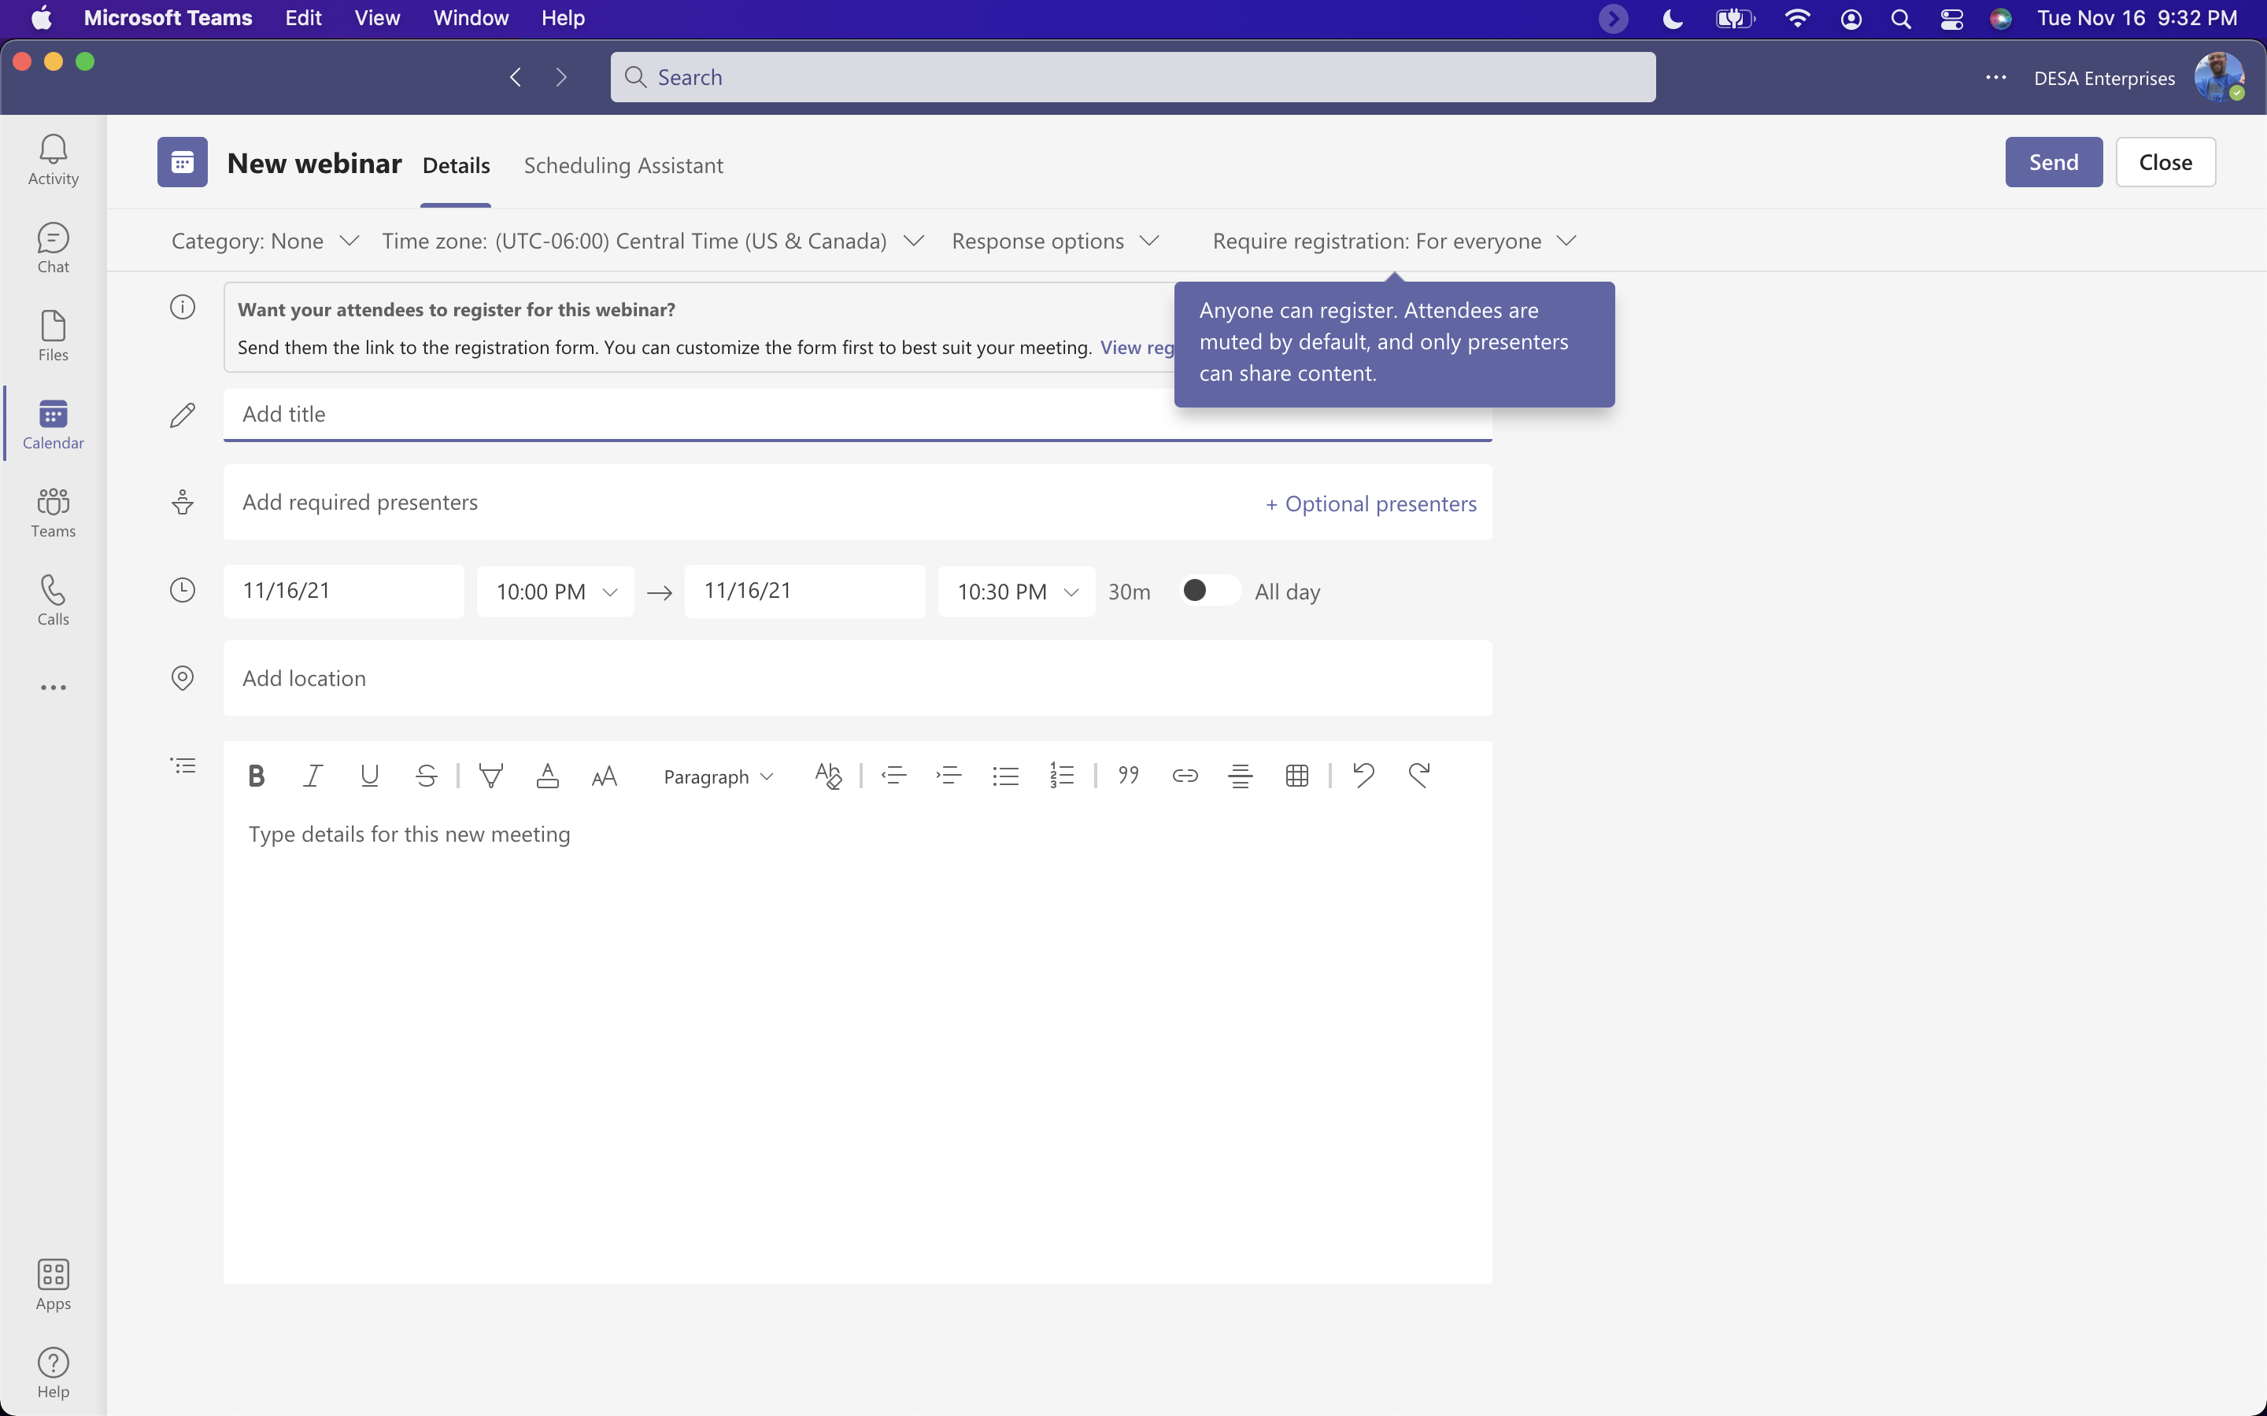
What are some of the settings?

Slide 19
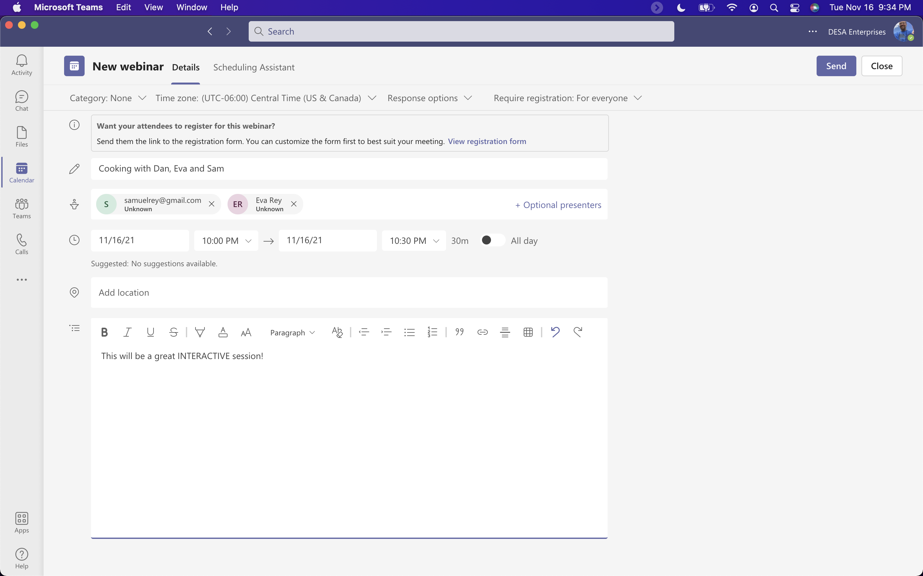
New Webinar

Slide 20
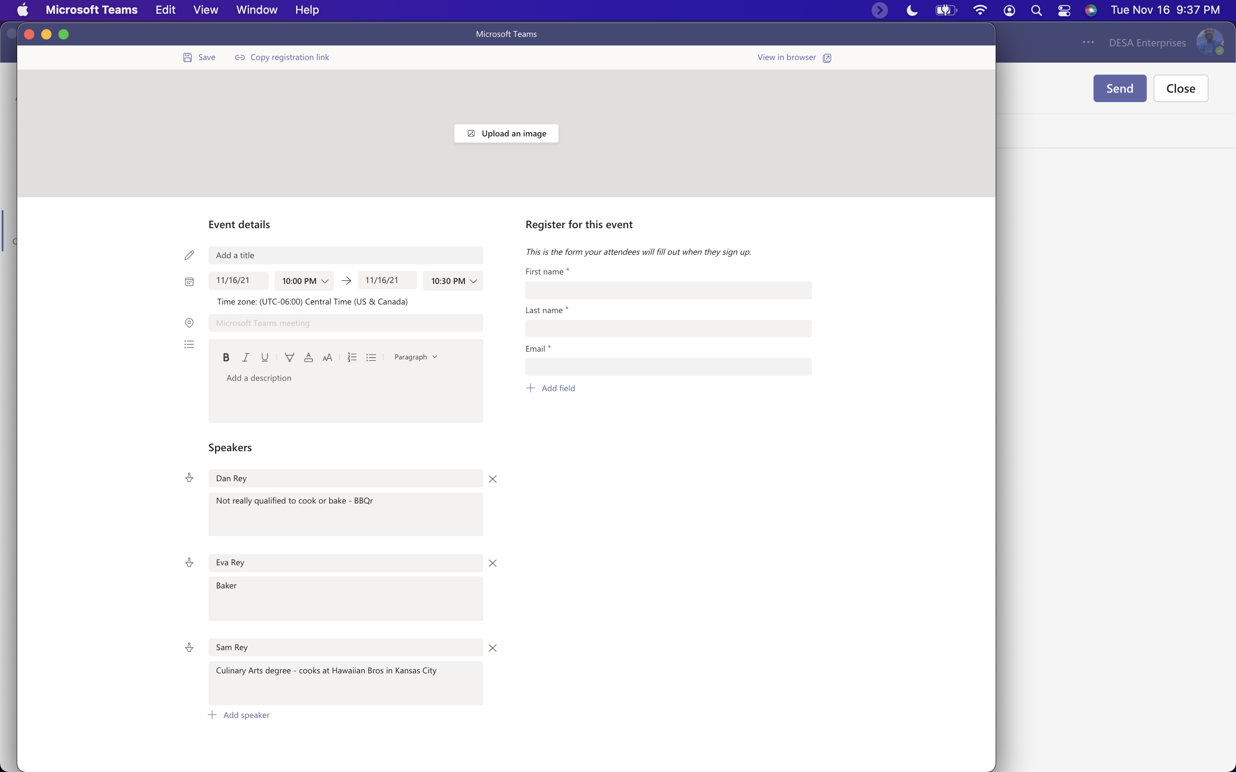
Webinar Registration Options

Slide 21
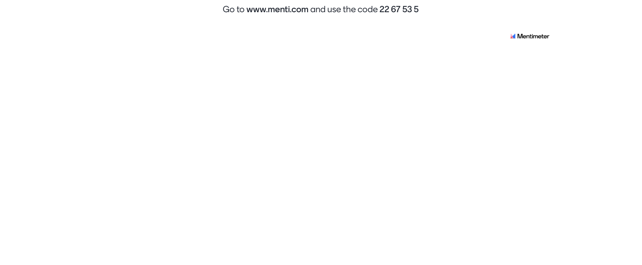

Slide 22
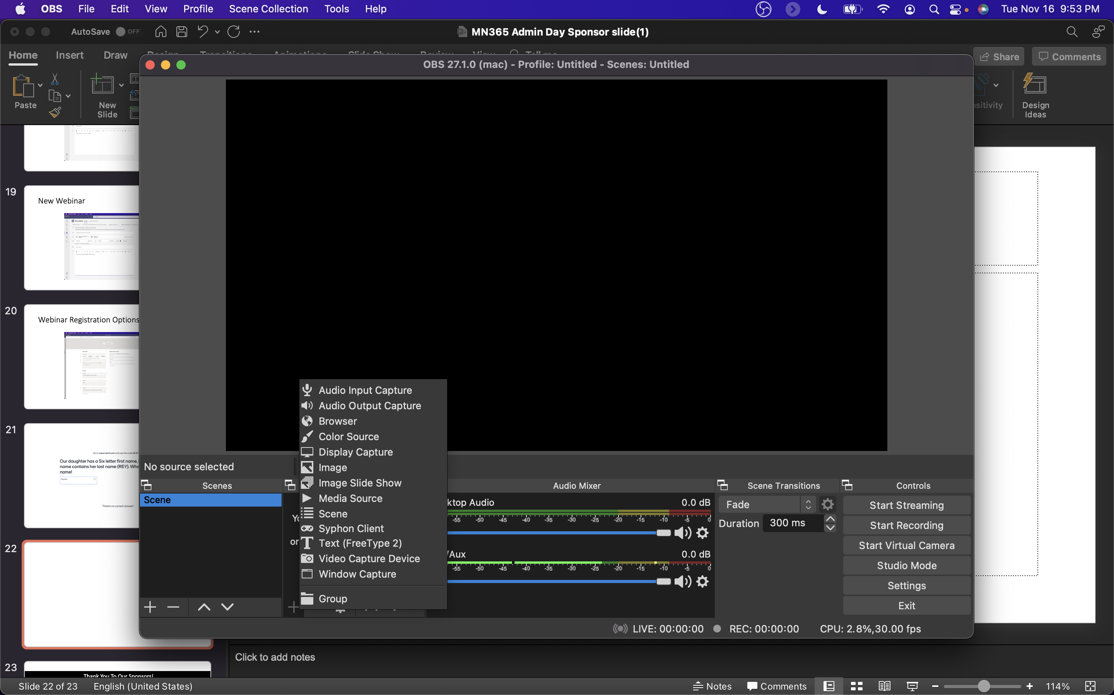
OBS (Open Broadcaster Software)

Slide 23
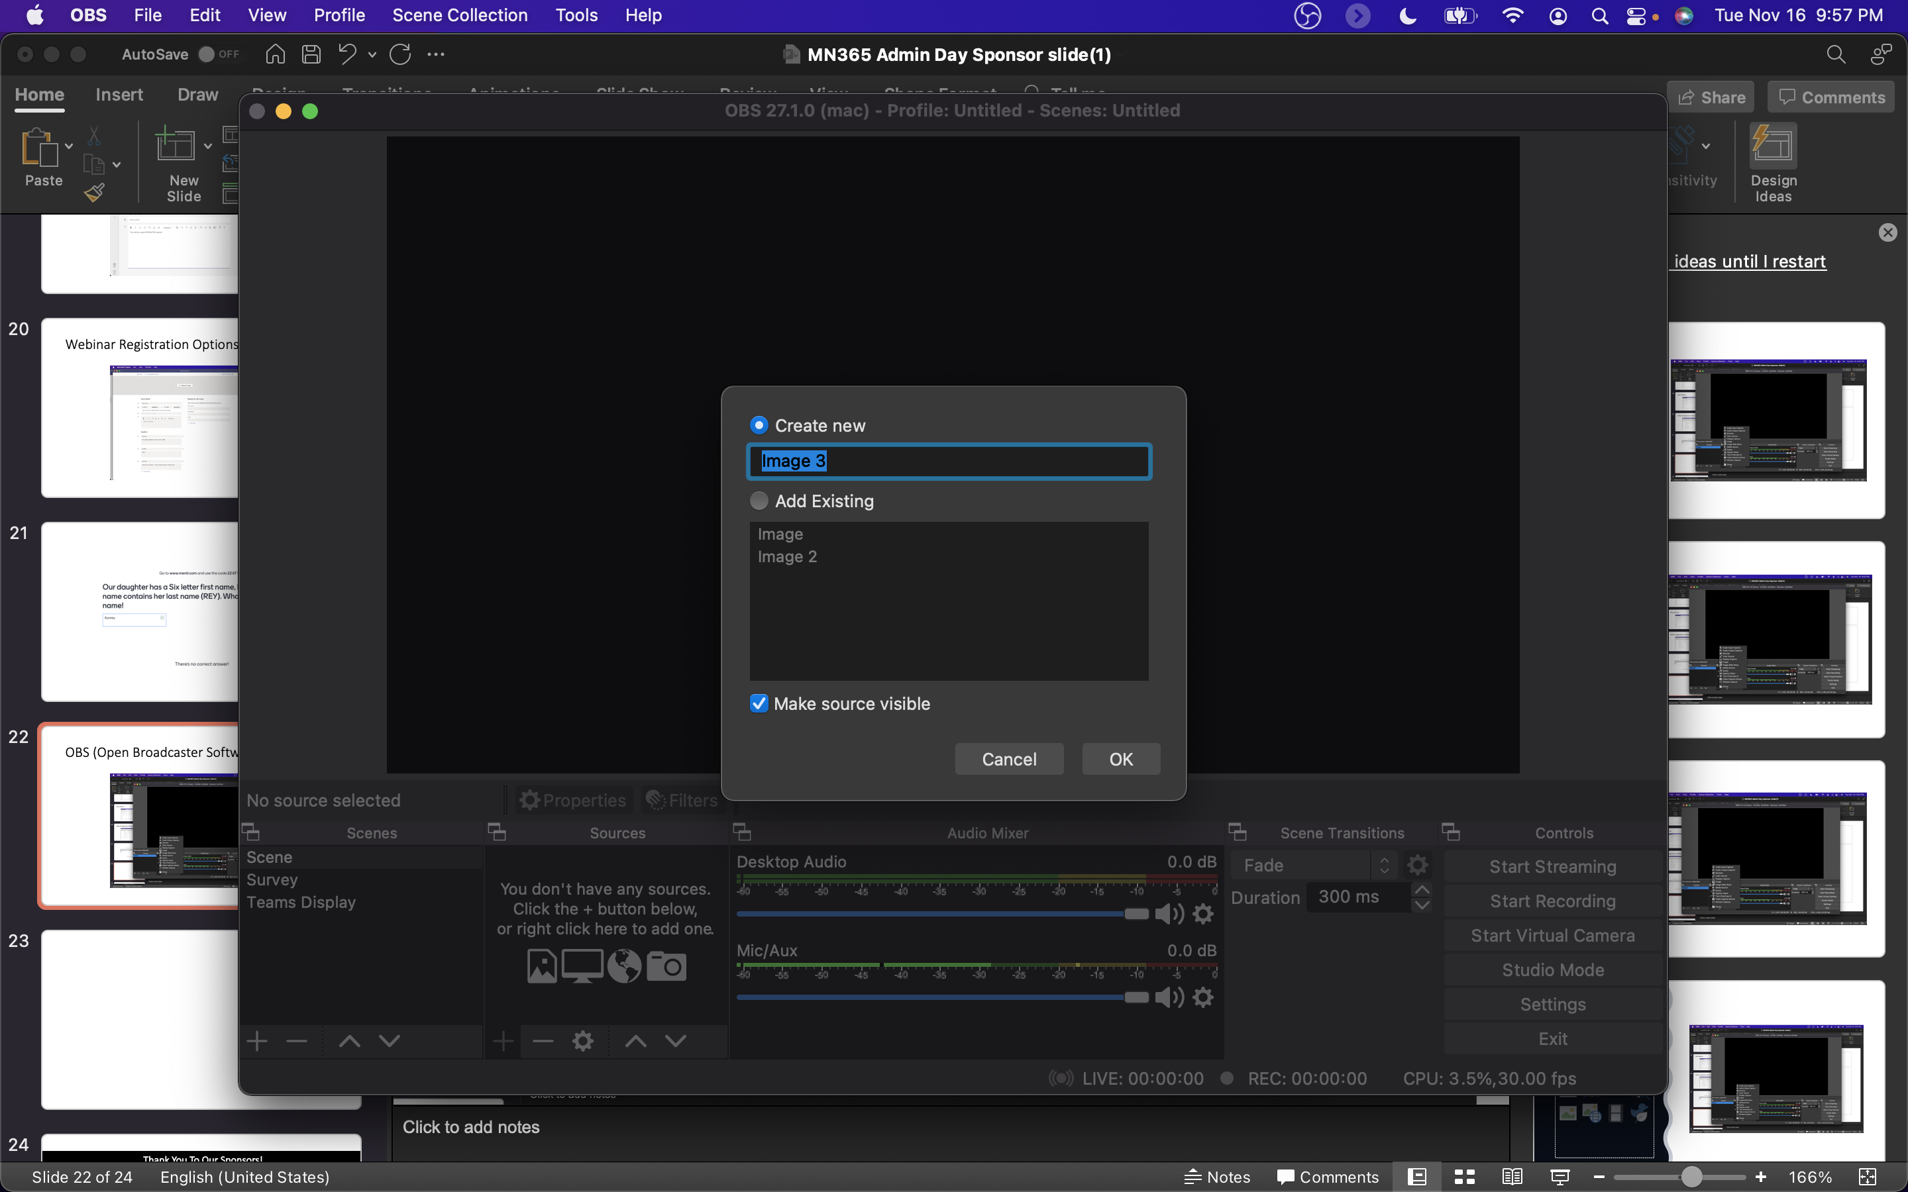

Slide 24
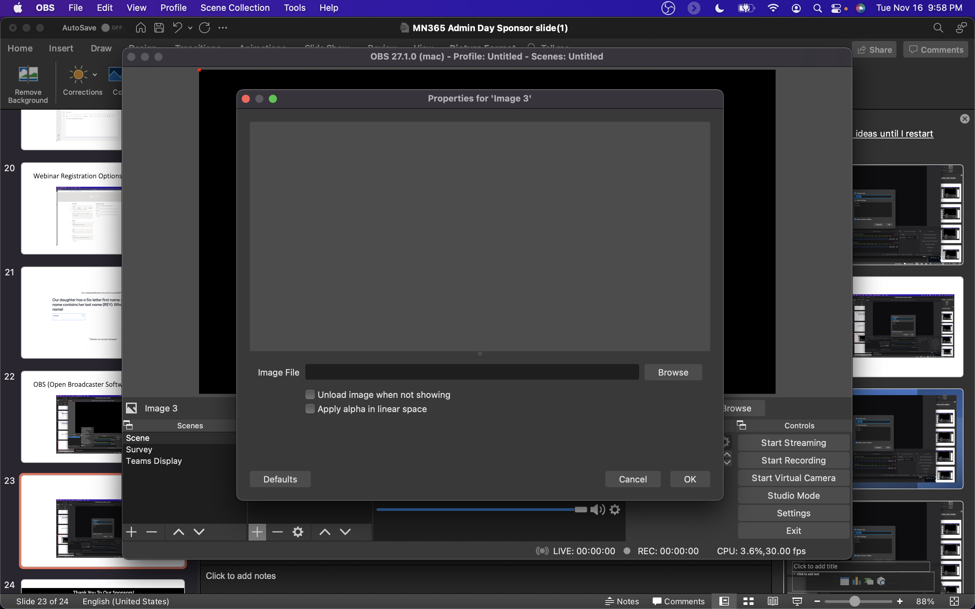

Slide 25
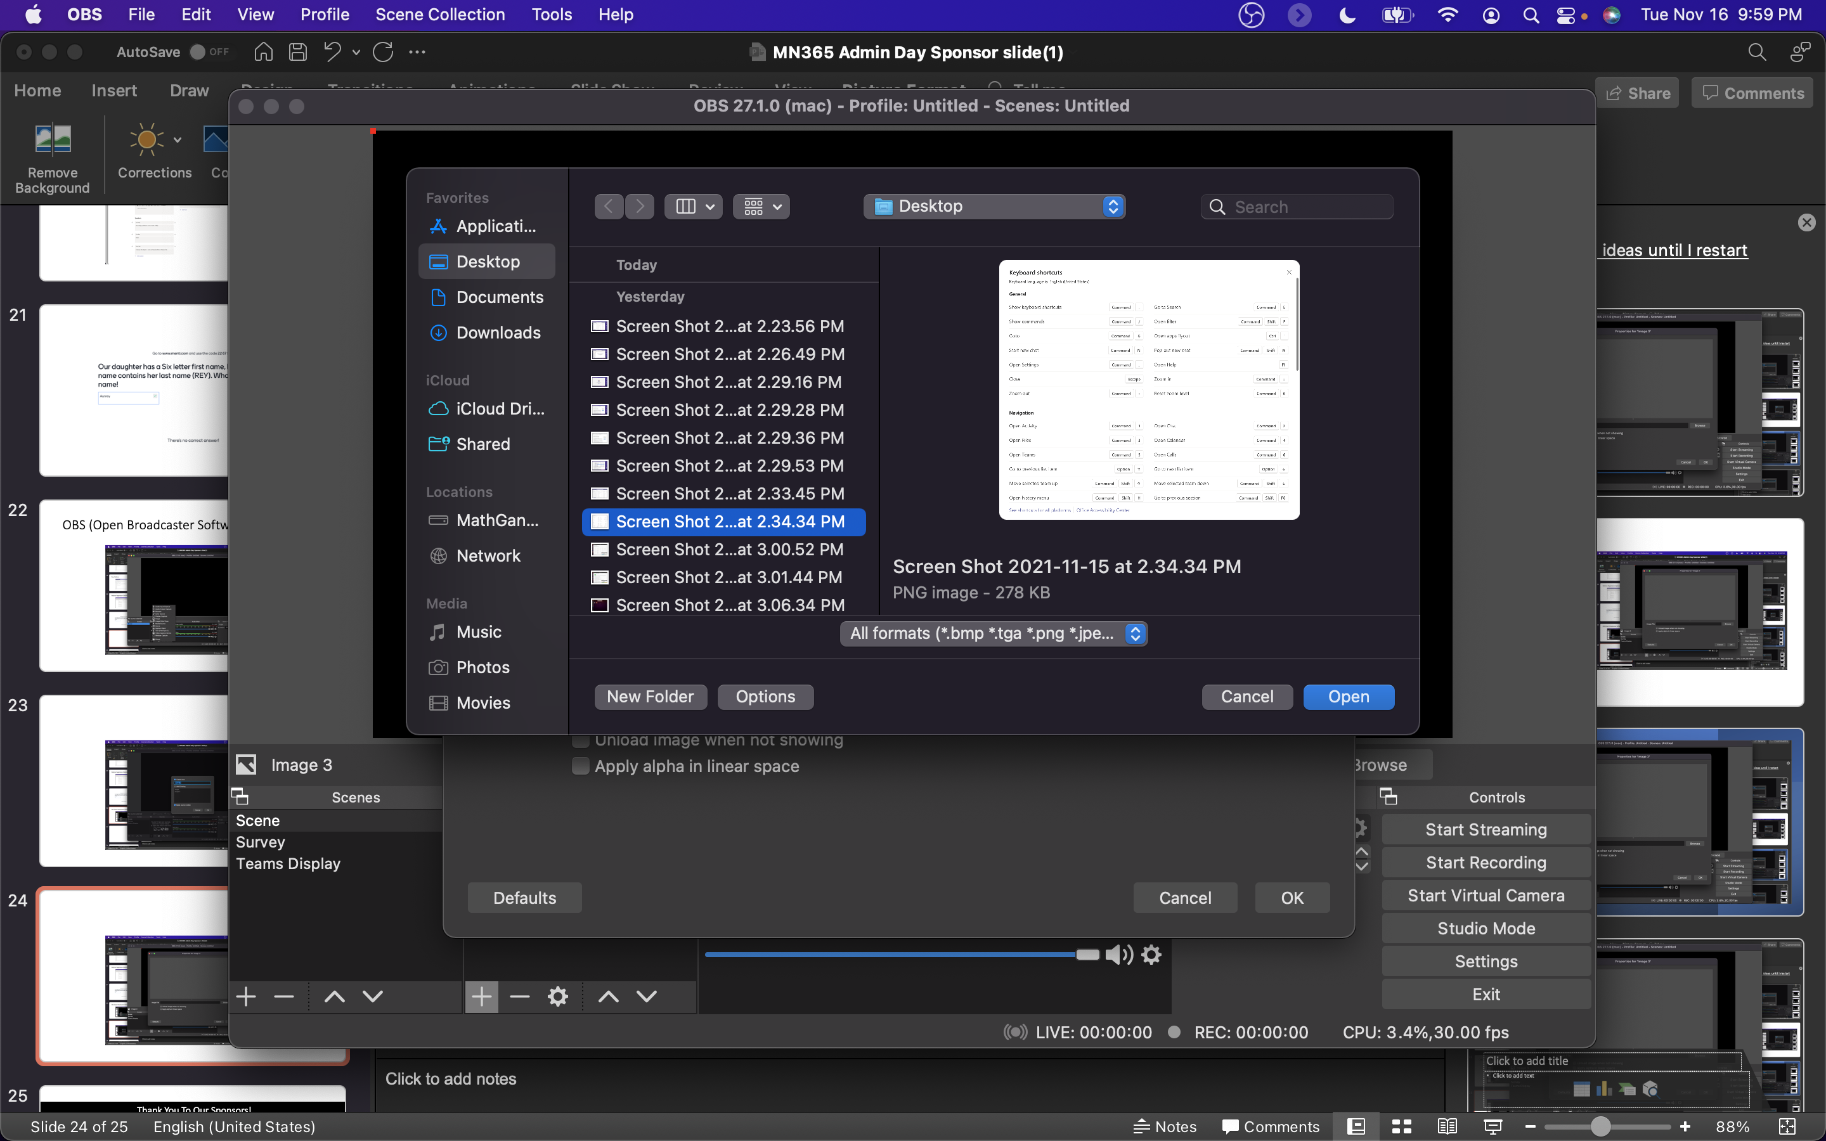
Microsoft Teams Keyboard Shortcuts

Slide 26
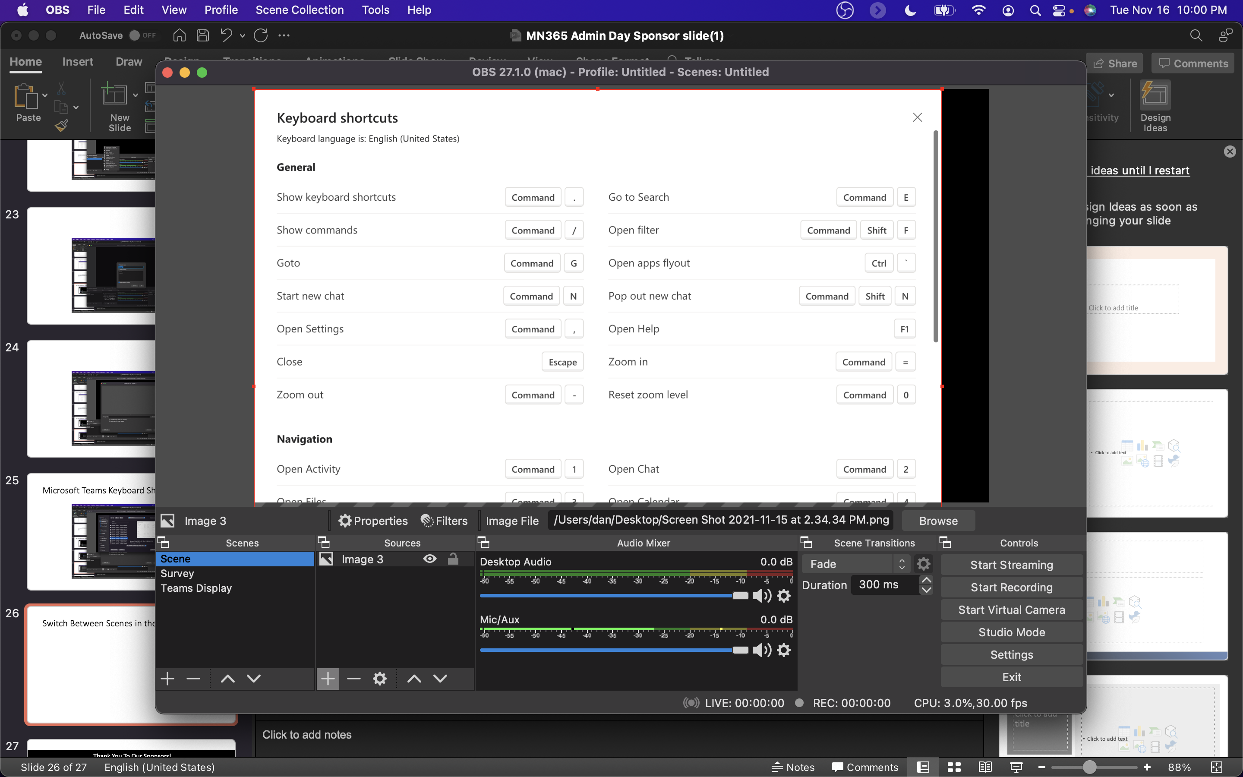
Switch Between Scenes in the lower left

Slide 27
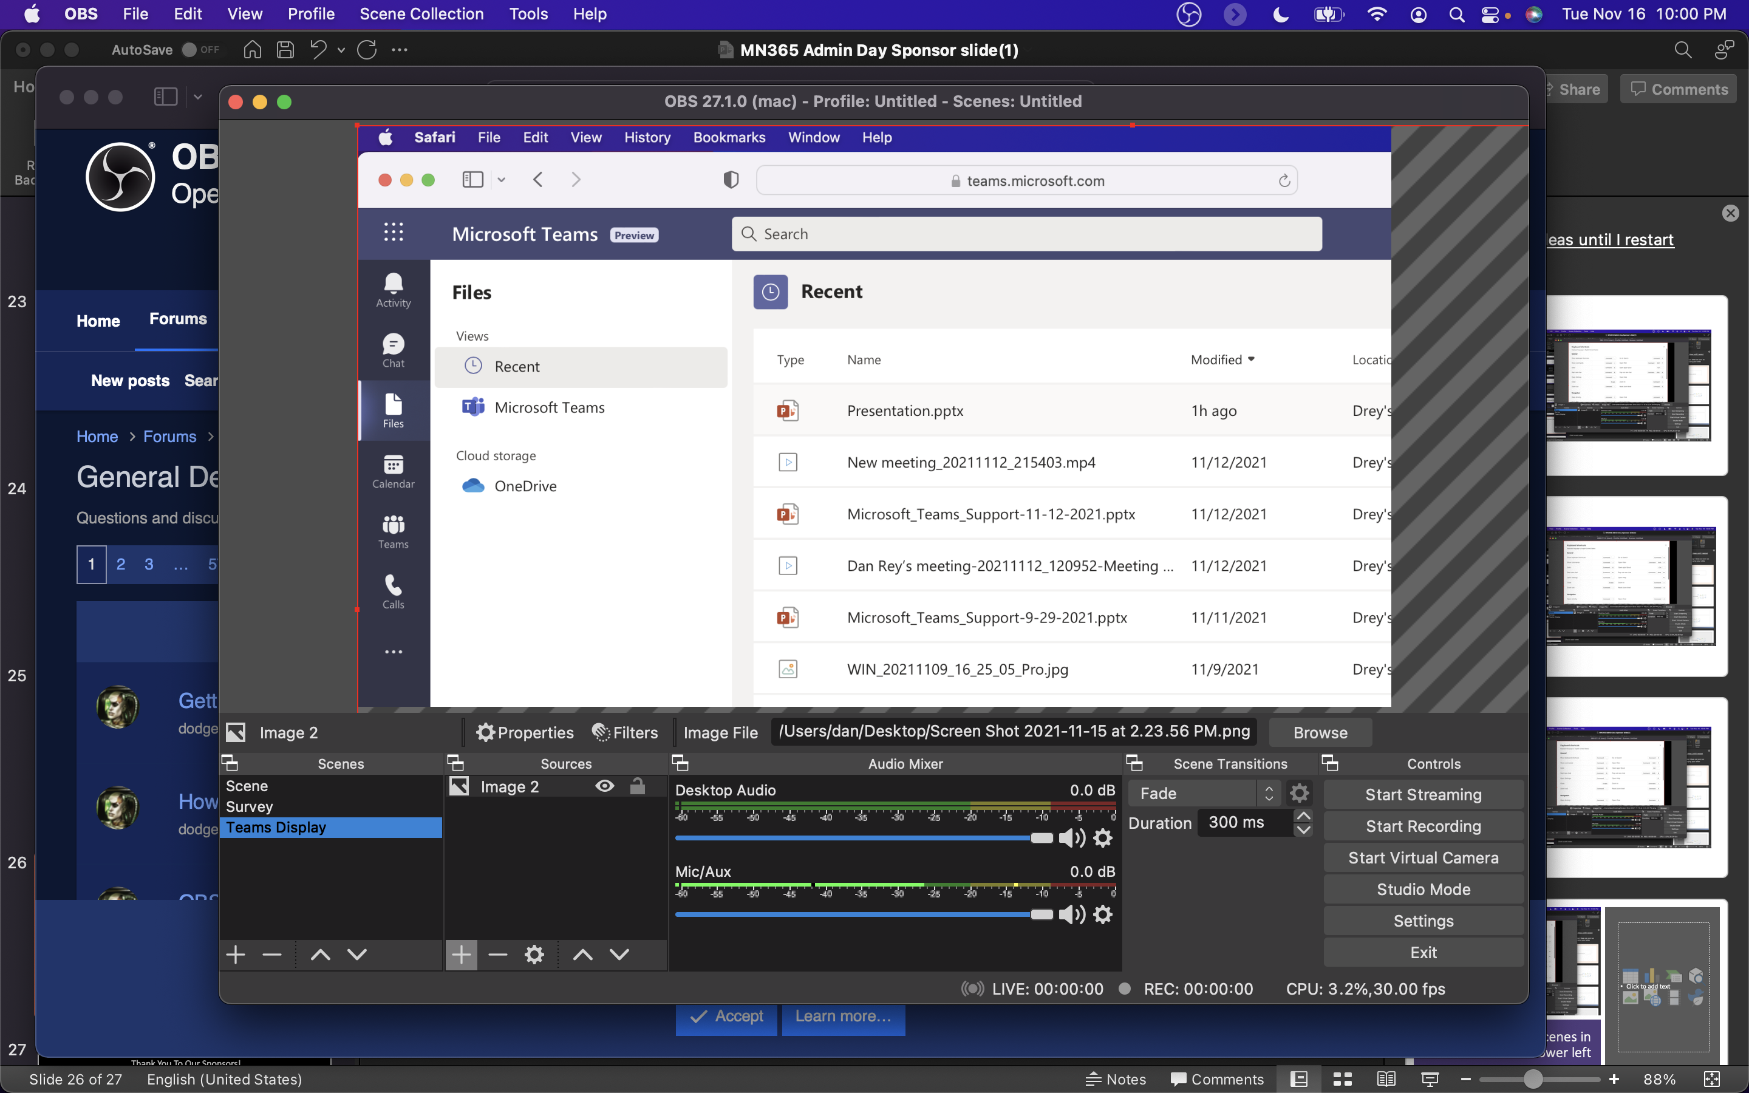
Composite (image, video, live camera, overlay layers, etc.)

Slide 28
Live Event vs Webinar
Live Event
Webinar
Produced/thousands in audience
Portions may be live, portions may be prerecorded
Registration must be setup (MS Forms, etc.)
Q&A is moderated
Audience is not able to ask questions
Can use Teams, OBS or a 3rd party app or device
More like a meeting/up to 1,000 participants
Typically a meeting that happens real time (could be recorded)
Registration ahead of time (built into the setup)
Chat is in the meeting with all participants
Audience can interact/be on video/etc. see the chat
Can use Teams, OBS, mobile versions, you have more choices with audience

Slide 29








Thank You To Our Sponsors!

